Slide 1
Data Exploration Assignment
GROUP #7
WENHAO LUO
XUENAN WANG
DAPENG JIN
JIN XU
ARTH DESAI

Slide 2
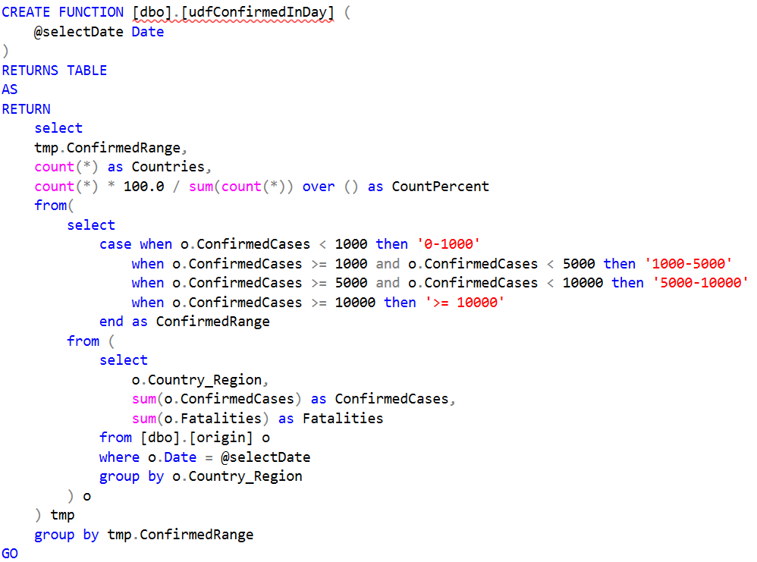
Univariate Analysis
COUNT() and COUNT()%
Build a UDF named udfConfirmedInDay()
Input is the date, for example: ‘2020-0404’
Output is the number of countries with confirmed cases in different range.

Slide 3
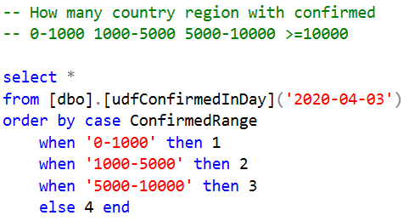
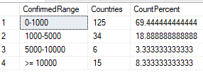
Univariate Analysis
COUNT() and COUNT()%

Slide 4
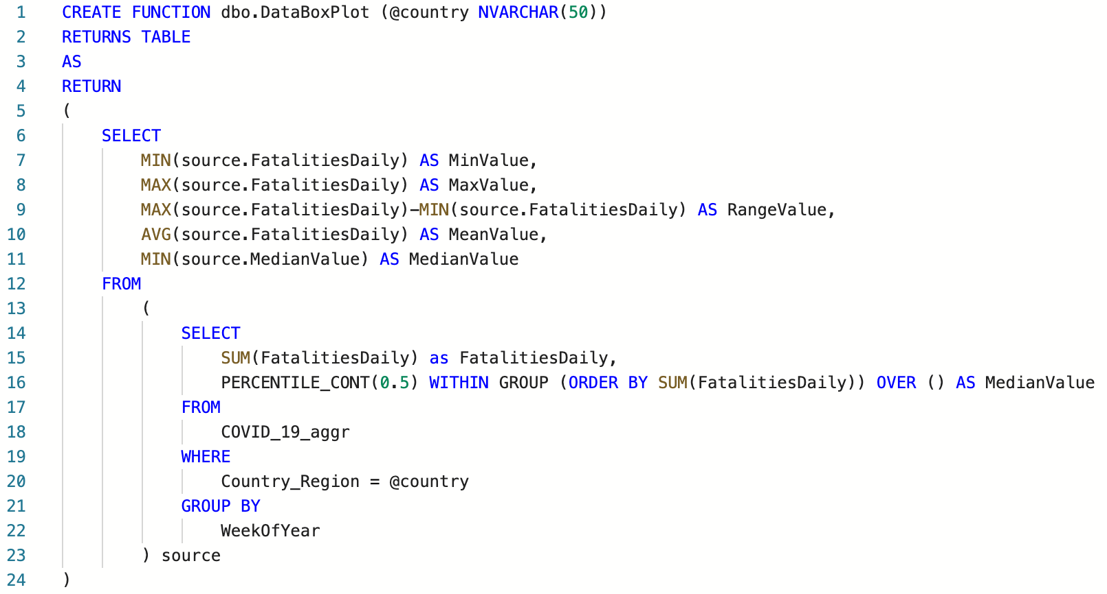
Univariate Analysis
BOX PLOT:
MIN, MAX, RANGE, MEAN, MEDIAN
Build a UDF named DataBoxPlot()
Input is country name, for example: ‘Italy’
Output is MIN, MAX, RANGE, MEAN, MEDIAN of FatalitiesDaily for this country weekly based.

Slide 5
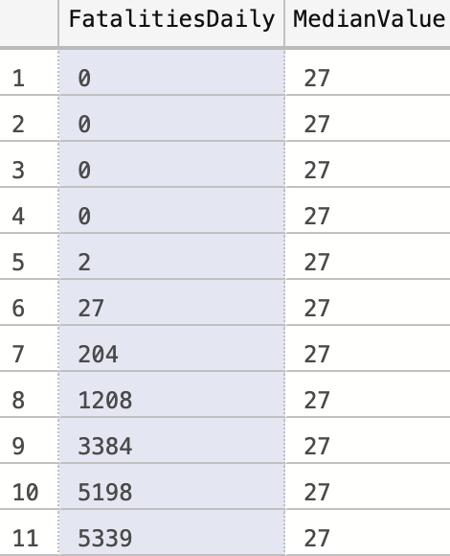

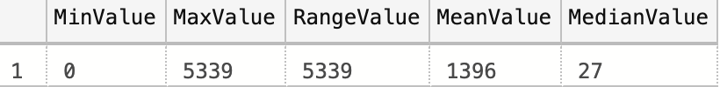
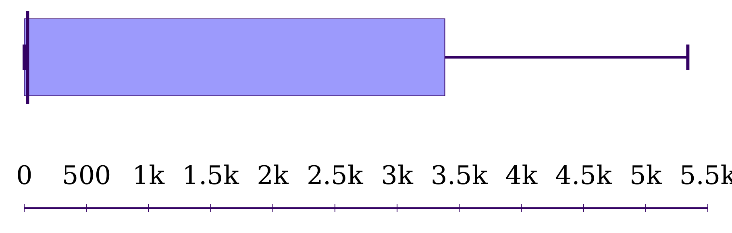
Univariate Analysis
Raw Data:
Test Result:

Slide 6
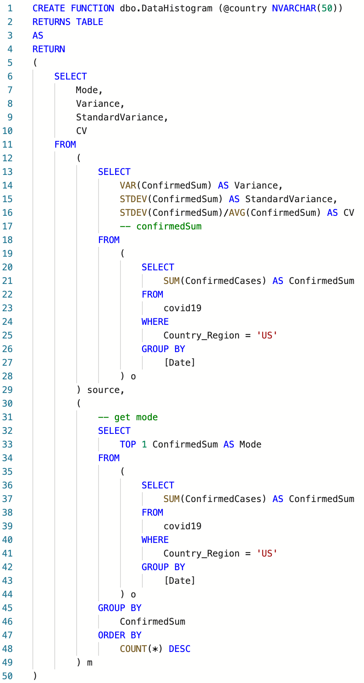
Univariate Analysis
HISTOGRAM:
MODE, VARIANCE, STANDARD VARIANCE, COEFFICIENT OF VARIATION
Build a UDF named DataHistogram()
Input is country name, for example: ‘Italy’
Output is MODE, VARIANCE, STANDARD VARIANCE, COEFFICIENT OF VARIATION of FatalitiesDaily for this country weekly based.

Slide 7
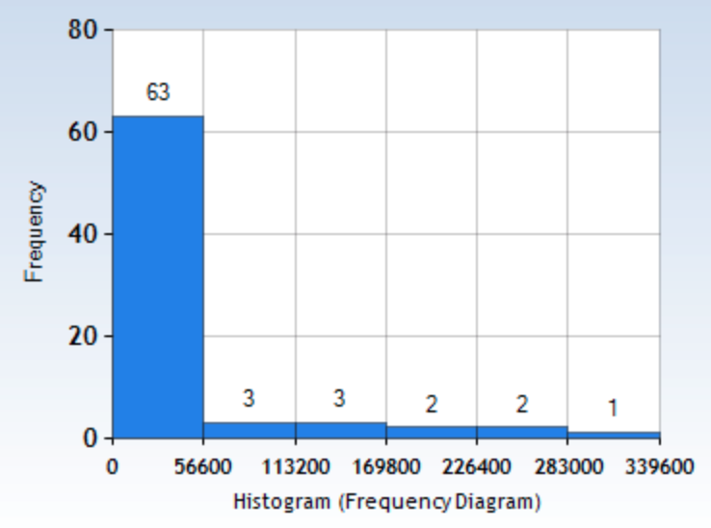


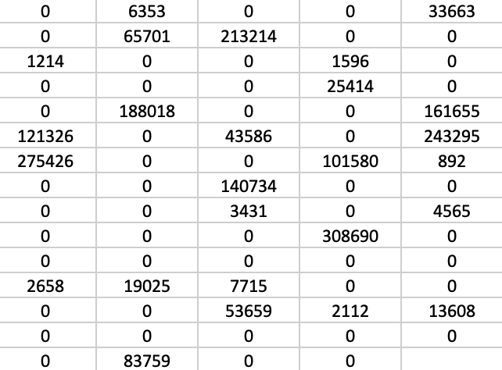
Univariate Analysis
Test Result:
Raw Data:

Slide 8
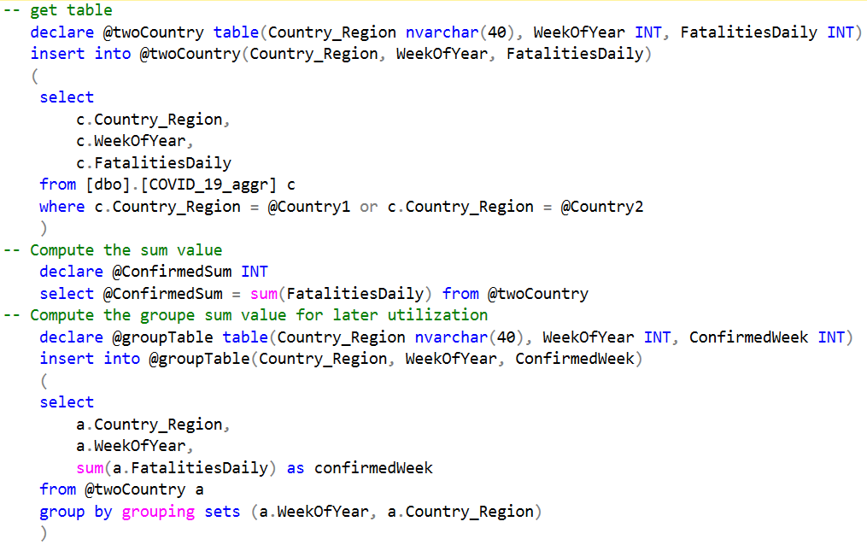
Bivariate Analysis
Chi2 Test for two Country against WeekOfYear

Slide 9
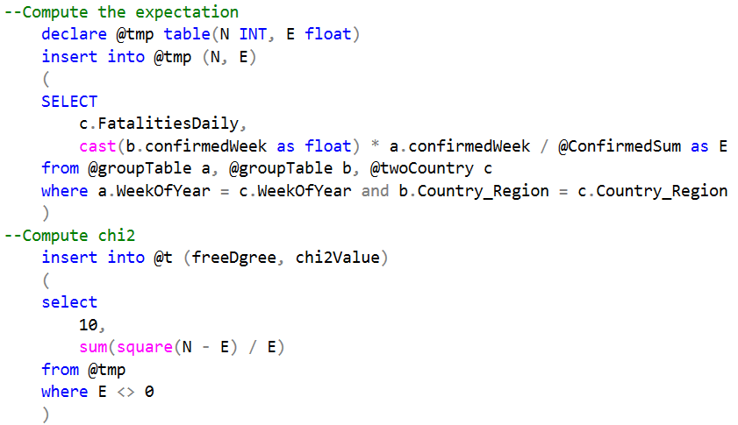
Bivariate Analysis
Chi2 Test for two Country against WeekOfYear

Slide 10
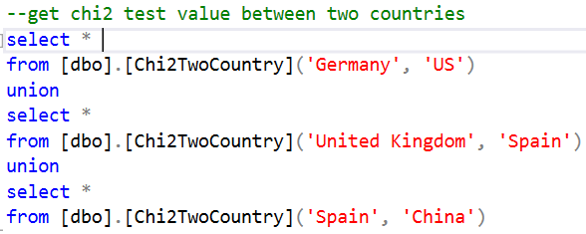

Bivariate Analysis
Chi2 Test for two Country
The countries we chosen don’t are all independent due to the chi2 values are larger than the critical value (18.307 for df = 10 with 0.05 probability) for rejection.
Correlation between two countries can vary drastically.

Slide 11
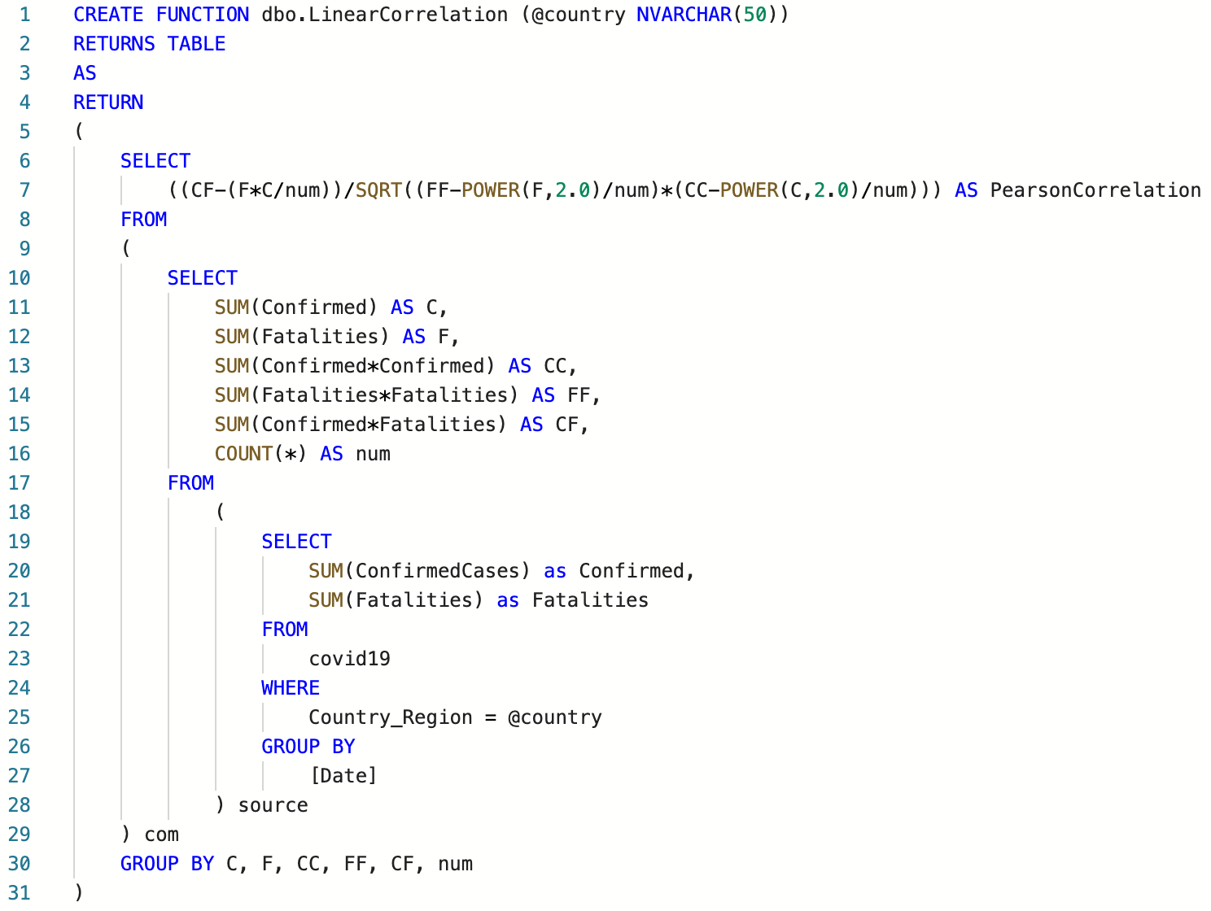


Bivariate Analysis
Linear Correlation
Linear Correlation of ConfirmedCases and Fatalities of a country on a daily aggregated data.
Test Result:
The result suggest that confirmed cases number is highly correlated with fatalities number.

Slide 12
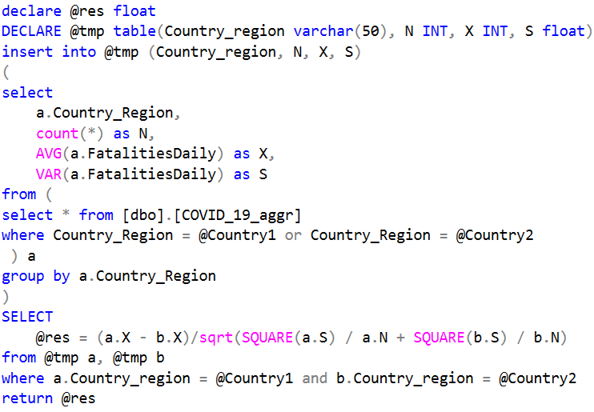


Bivariate Analysis
Z-Value Test for two Country
Again, We double test the independence between different countries. The small Z-value infers the less correlation between them

